Slide 1

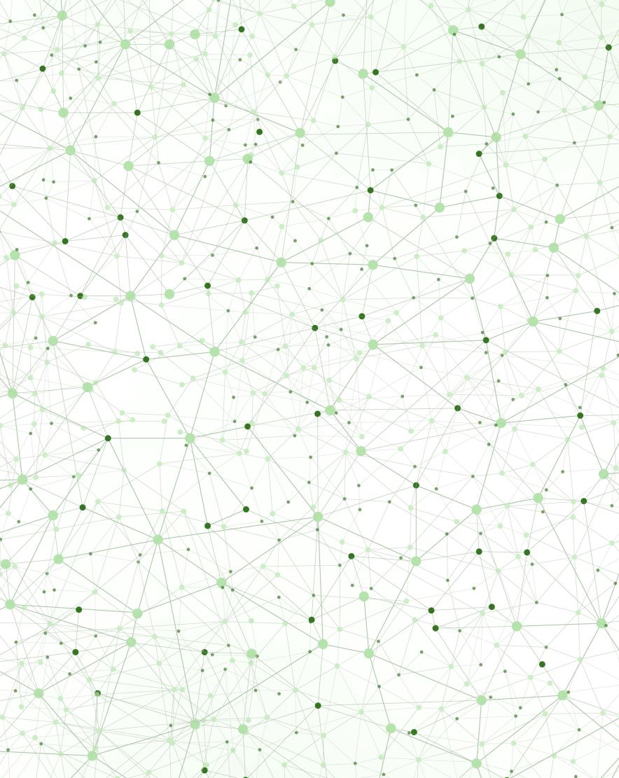
Mol-Optimizer Marathon Presentation
Amit Peled, Daniel Piro, Shahar Alon & Nofar Rozenberg

Slide 2
What is Mol-Optimizer? (A Short Reminder)
MolOptimizer (MolOpt) is a web-application that was developed to be used by researchers working in the field of Small Fragment based inhibitors and is intended to be helpful in optimization of ligand databases.
The main purpose of the MolOpt, is to replace the “docking” stage in finding suitable molecules.
Using MolOpt, we are replacing the docking stage, which is takes a lot of time and resources, with some machine learning algorithms – that way, we can make these molecules finding processes much easier and cheaper.

Slide 3
Tasks, Challenges & Achievements During The Marathon
Integrate between the Frontend and the Backend (putting our APIs into use).
Added database to the system.
Finish the final & new UI design.
Working to get the algorithms ready to use.

Slide 4
Integrate Between The Frontend & The Backend
Until the marathon, the frontend and the backend were existed on 2 different branches. both were existed separately in the system.
This task in the marathon, focused on taking the API’s URLs created in the backend and putting them into use in the frontend.
Big challenge we faced during the marathon:
We noticed that our backends' virtual environment worked only on specific cases. During the marathon we managed to fix that issue, and we created a virtual environment that works at any case.

Slide 5
Added Database To The System
We created our project’s MongoDB Database.
We managed to connect our database to the system successfully (both the website and the database run very well together).

Slide 6
Finish UI design
This was a big task that started before the marathon and ended during the marathon.
We changed completely the UI design and used Material UI (with the existing React JS) in order to give our website a better UI which is:
Better looking.
Easier to understand and Easier to use – “User friendly”.
Responsive – The website fits any screen size and any browser it runs on.

Slide 7
Working To Get The Algorithms Ready To Use In The “Real” System
At the moment, there are still some issues running all the algorithms outside of the PC labs.
We managed to get a few of them running outside of the PC labs but it still not ready to be integrated to the UI in out system.
As soon as these algorithms will be ready (which should be happening soon) the whole system will be ready to run with full functionality.

Slide 8
Future Work In Mol-Optimizer Project
Getting the Algorithms work on the existing system.
Adding Security
Our costumer gives great importance to security/safety issues in the system.
We need to make sure that our system is fully secured before we’ll deploy it to the server
Deploy the website to the University’s Server.
Optimizing the Algorithms

Slide 9
Thank You! ☺

